Slide 1

6th Grade Accelerated Math
Unit 12, Lesson 5 Determining Tax, Tip, or Fees Given a Percentage Volume 2, pg. 234

Slide 2


Benchmark
MA.7.AR.3.1
Apply previous understanding of percentages and ratios to solve multi-step, real-world percent problems.
volume 2, pg. 234

Slide 3
Integrated Mathematical Thinking and Reasoning Standards
MA.K12.MTR.3.1 Complete tasks with mathematical fluency.
MA.K12.MTR.6.1 Assess the reasonableness of solutions.
MA.K12.MTR.7.1 Apply mathematics to real-world contexts.
volume 2, pg. 234

Slide 4

Learning Targets
I can determine the amount of tax, tip, or fee given a percentage.
I can determine the percentage of a discount or markup.
volume 2, pg. 234

Slide 5

Warm-Up
volume 2, pg. 235

Slide 6
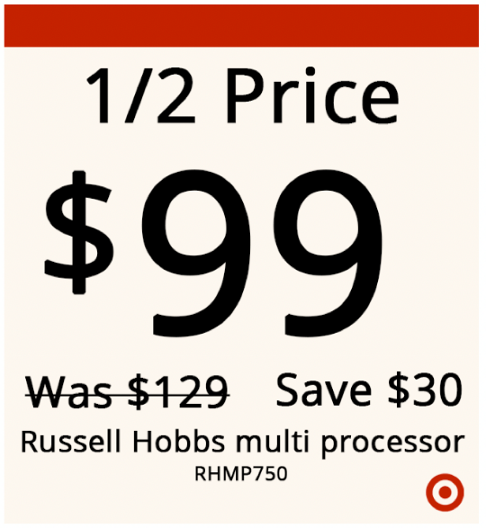
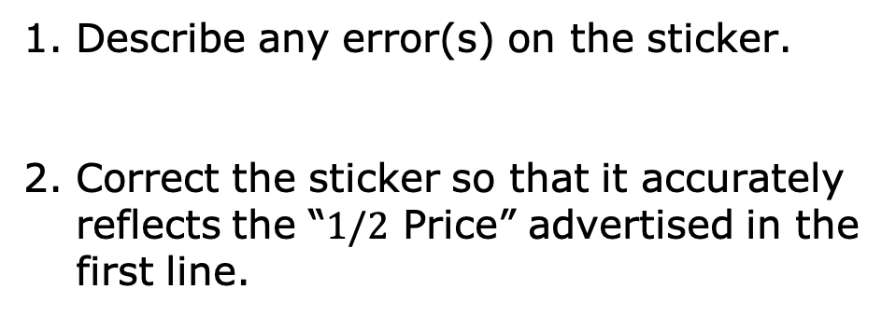
12.5.1 Warm-Up: Math Fail
The following sticker was placed on an item for sale.
Describe any error(s) on the sticker.
Correct the sticker so that it accurately reflects the “$1/2$ Price” advertised in the first line.
volume 2, pg. 235

Slide 7

Guided Instruction
volume 2, pg. 235

Slide 8
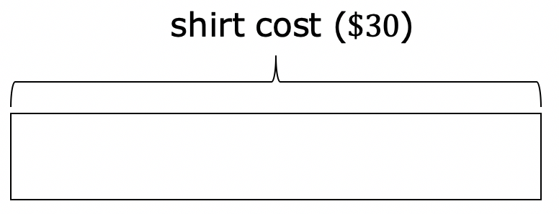
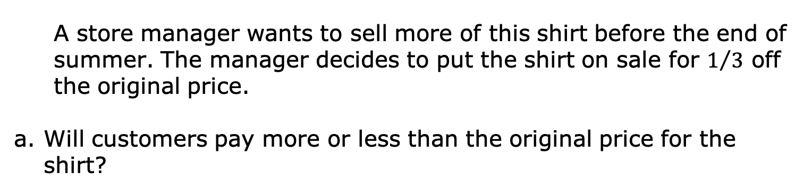
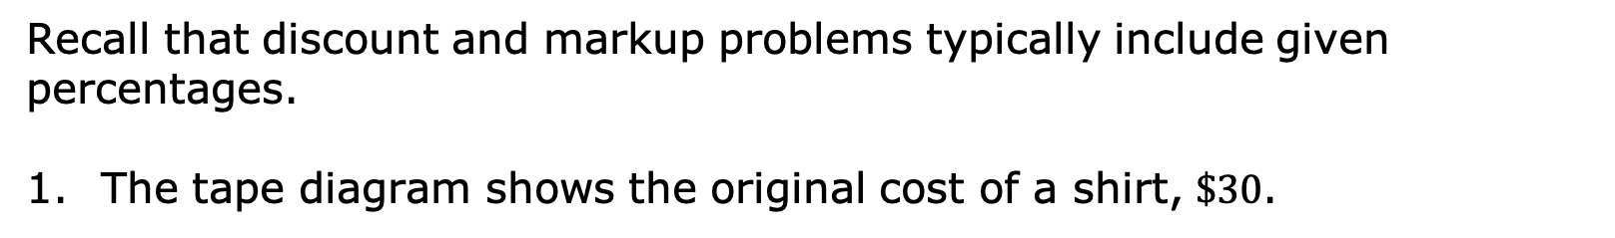
12.5.2 Guided Instruction: Finding the Percentage of a Discount or Markup
Recall that discount and markup problems typically include given percentages.
The tape diagram shows the original cost of a shirt, $\$30$.
A store manager wants to sell more of this shirt before the end of summer. The manager decides to put the shirt on sale for $1/3$ off the original price.
Will customers pay more or less than the original price for the shirt?
volume 2, pg. 235

Slide 9
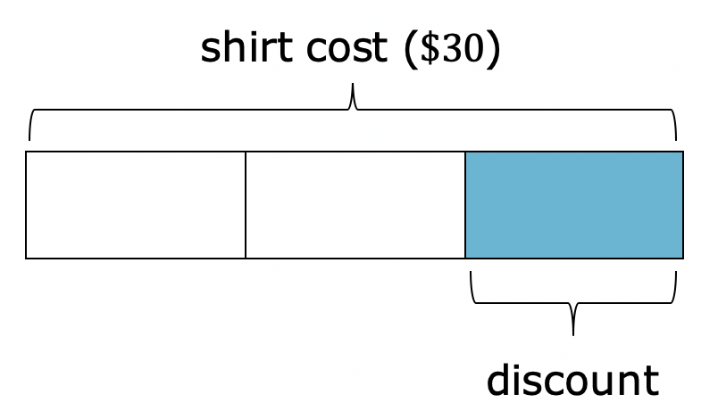
The tape diagram is divided into thirds.
What is the price of the shirt after the discount?
volume 2, pg. 235

Slide 10
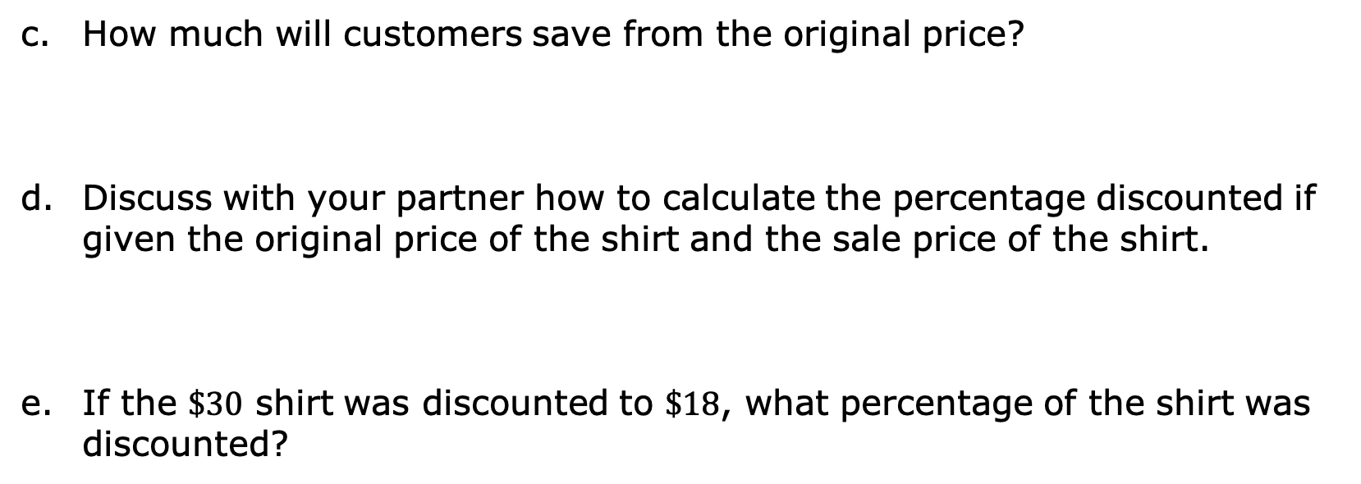
How much will customers save from the original price?
Discuss with your partner how to calculate the percentage discounted if given the original price of the shirt and the sale price of the shirt.
If the $\$30$ shirt was discounted to $\$18$, what percentage of the shirt was discounted?
volume 2, pg. 236

Slide 11
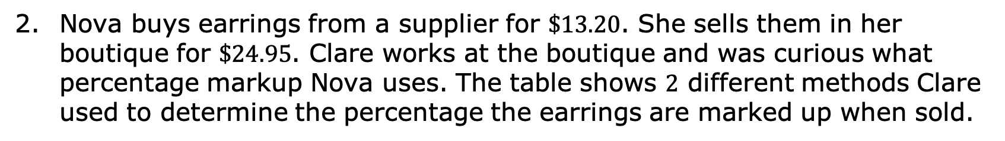
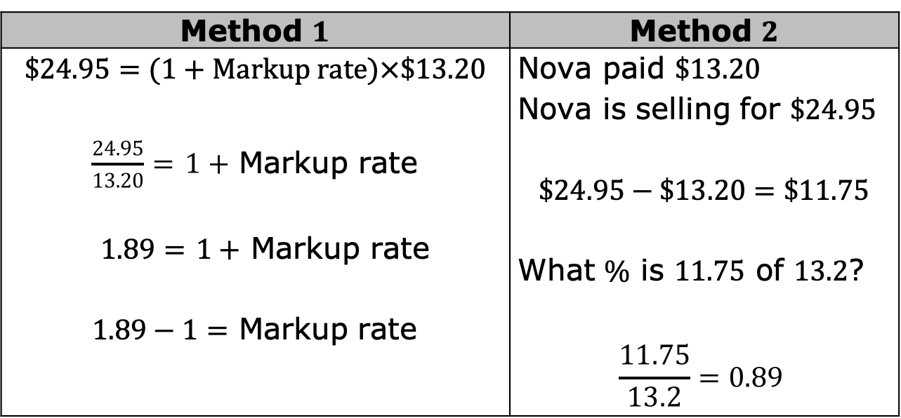
Nova buys earrings from a supplier for $\$13.20$. She sells them in her boutique for $\$24.95$. Clare works at the boutique and was curious what percentage markup Nova uses. The table shows $2$ different methods Clare used to determine the percentage the earrings are marked up when sold.
Method $1$ | Method $2$
$$\$24.95=(1+Markup rate)×\$13.20$$ $\frac{24.95}{13.20}=$ $1+$ Markup rate $1.89=$ $1+$ Markup rate $1.89−1=$ Markup rate | Nova paid $\$13.20$ Nova is selling for $\$24.95$ $$\$24.95−\$13.20=\$11.75$$ What $\%$ is $11.75$ of $13.2$? $$\frac{11.75}{13.2}=0.89$$
volume 2, pg. 236

Slide 12
Compare both methods. Discuss the similarities and differences in the two methods with your partner. Then, write them in the table.
What is the percentage of the markup?
Similarities | Differences
volume 2, pg. 236

Slide 13

Try It
volume 2, pg. 237

Slide 14

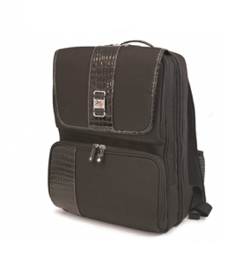

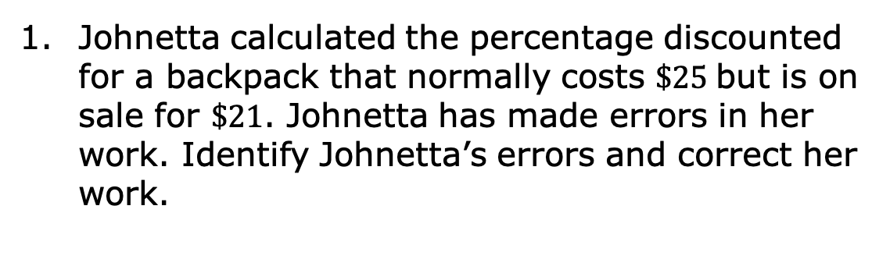
12.5.3 Try It: Finding the Percentage of a Discount or Markup
Johnetta calculated the percentage discounted for a backpack that normally costs $\$25$but is on sale for $\$21$. Johnetta has made errors in her work. Identify Johnetta’s errors and correct her work.
Backpack original cost is $25
Backpack sale cost is $21
$$\frac{\$25}{\$21}=1.19$$
Discount $1.19\%$
volume 2, pg. 237

Slide 15
Guided Instruction
volume 2, pg. 237

Slide 16
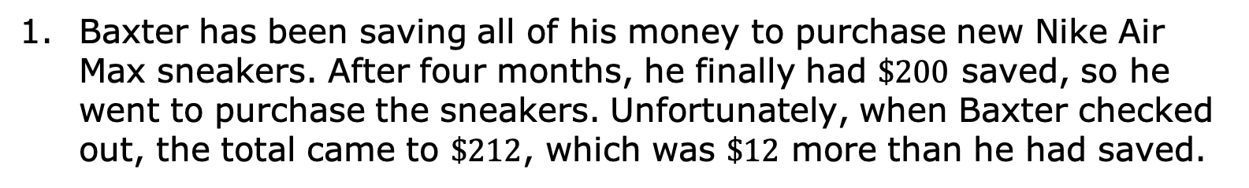
12.5.4 Guided Instruction: Taxes, Tips, and Fees
Baxter has been saving all of his money to purchase new Nike Air Max sneakers. After four months, he finally had $\$200$ saved, so he went to purchase the sneakers. Unfortunately, when Baxter checked out, the total came to $\$212$, which was $\$12$ more than he had saved.
Subtotal | $200.00
Estimated Shipping | $0.00
Estimated Tax | $12.00
TOTAL | $212.00
volume 2, pg. 237

Slide 17
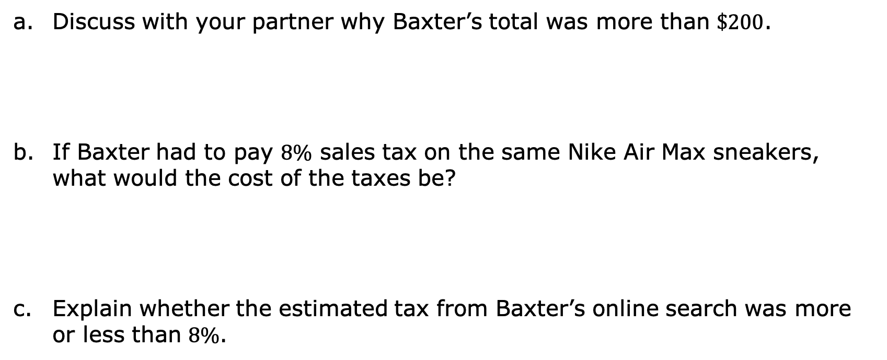
Subtotal | $200.00
Estimated Shipping | $0.00
Estimated Tax | $12.00
TOTAL | $212.00
Discuss with your partner why Baxter’s total was more than $\$200$.
If Baxter had to pay $8\%$ sales tax on the same Nike Air Max sneakers, what would the cost of the taxes be?
Explain whether the estimated tax from Baxter’s online search was more or less than $8\%$.
volume 2, pg. 237

Slide 18
Work with your partner to complete the following.
The Cardone Family is planning to have a birthday celebration at one of their favorite restaurants. The restaurants they are considering are in different counties that each have different sales tax rates.
volume 2, pg. 238

Slide 19
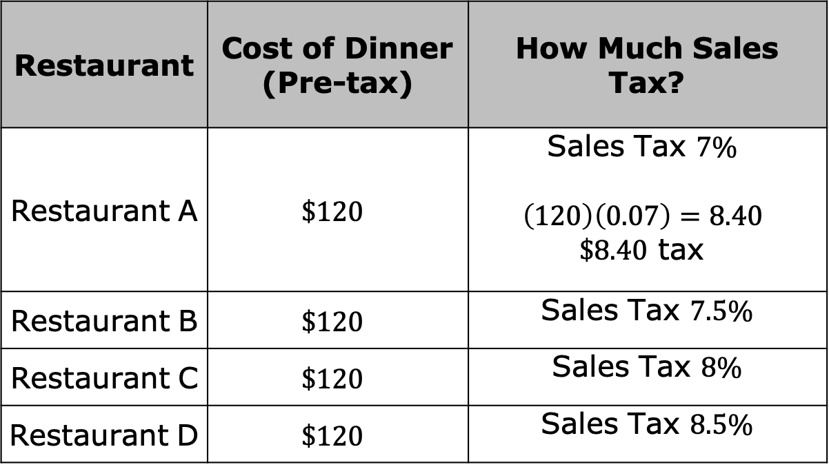
Complete the table to determine how much tax will be at each restaurant given the same pre-tax cost of dinner. The first row of the table has been completed.
Restaurant | Cost of Dinner (Pre-tax) | How Much Sales Tax?
Restaurant A | $$\$120$$ | Sales Tax $7\%$ $$\left(120\right)\left(0.07\right)=8.40$$ $\$8.40$ tax
Restaurant B | $$\$120$$ | Sales Tax $7.5\%$
Restaurant C | $$\$120$$ | Sales Tax $8\%$
Restaurant D | $$\$120$$ | Sales Tax $8.5\%$
volume 2, pg. 238

Slide 20
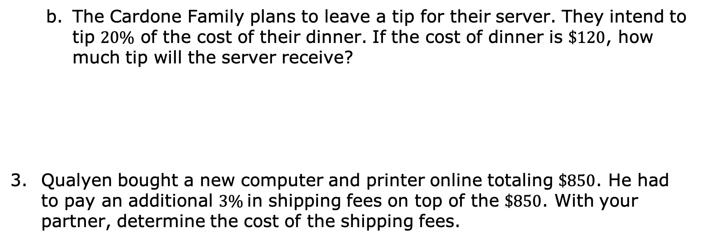
The Cardone Family plans to leave a tip for their server. They intend to tip $20\%$ of the cost of their dinner. If the cost of dinner is $\$120$, how much tip will the server receive?
Qualyen bought a new computer and printer online totaling $\$850$. He had to pay an additional $3\%$in shipping fees on top of the $\$850$. With your partner, determine the cost of the shipping fees.
volume 2, pg. 238

Slide 21
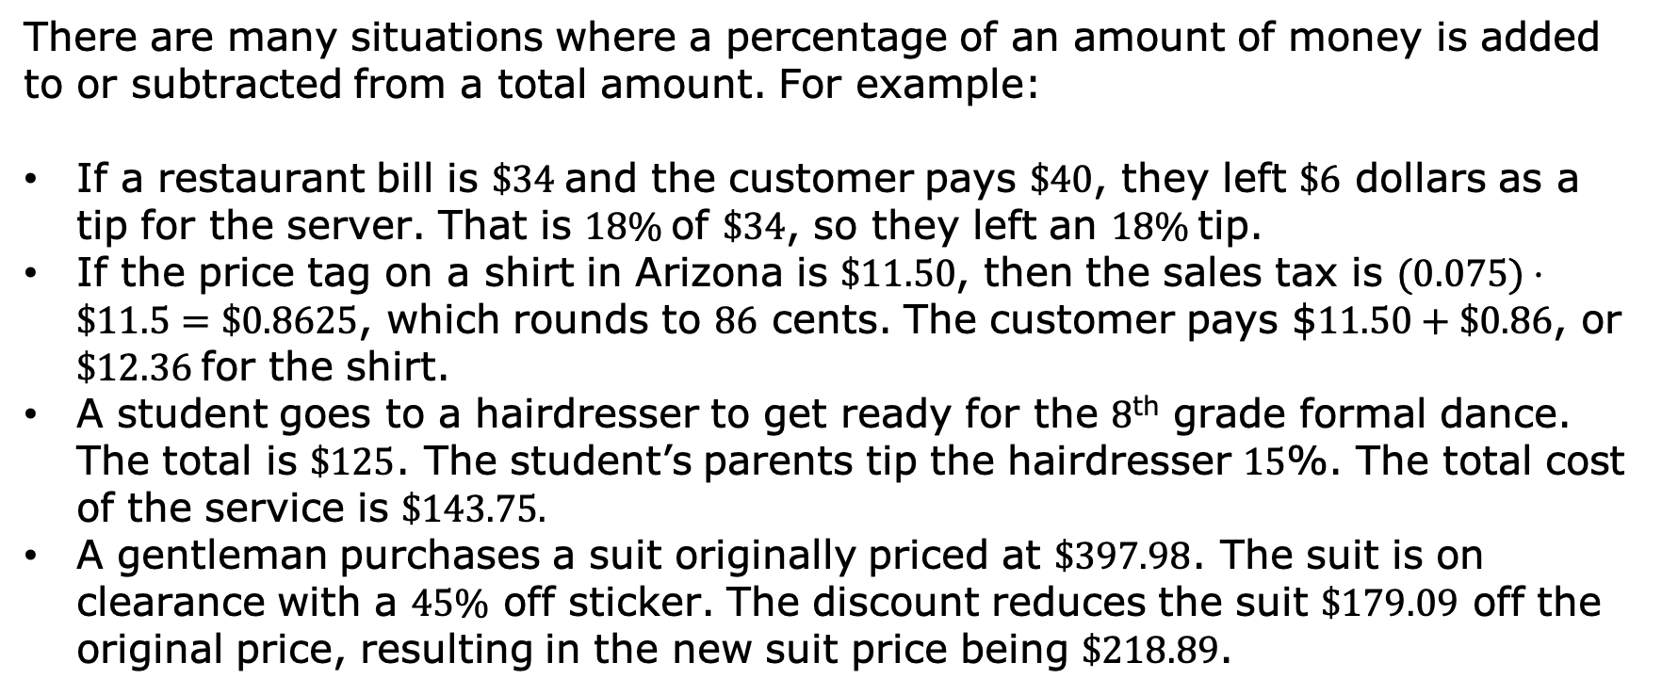
There are many situations where a percentage of an amount of money is added to or subtracted from a total amount. For example:
If a restaurant bill is $\$34$and the customer pays $\$40$, they left $\$6$ dollars as a tip for the server. That is $18\%$of $\$34$, so they left an $18\%$tip.
If the price tag on a shirt in Arizona is $\$11.50$, then the sales tax is $(0.075)⋅\$11.5=\$0.8625$, which rounds to $86$ cents. The customer pays $$11.50+\$0.86$, or $\$12.36$for the shirt.
A student goes to a hairdresser to get ready for the $8$^{th} grade formal dance. The total is $\$125$. The student’s parents tip the hairdresser $15$%. The total cost of the service is $\$143.75.$
A gentleman purchases a suit originally priced at $\$397.98$. The suit is on clearance with a $45\%$ off sticker. The discount reduces the suit $\$179.09$ off the original price, resulting in the new suit price being $\$218.89$.
volume 2, pg. 239

Slide 22
 | Goes to | How It Works
Sales Tax | The government | Added to the price of the item
Gratuity (Tip) | The person providing the service | Added to the cost of the service
Markup | The seller | Added to the cost of an item so the seller can make a profit
Markdown (Discount) | The customer | Subtracted from the price of an item to encourage the customer to buy it
Commission | The salesperson | Percentage of the value of the sale that is subtracted from the total sale and given to the salesperson
volume 2, pg. 239

Slide 23

Guided Practice
volume 2, pg. 239

Slide 24

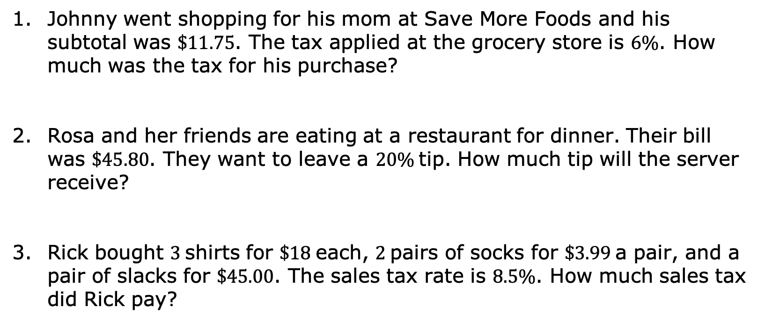
12.5.5 Guided Practice: Calculating Tax, Tip, and Fees
Johnny went shopping for his mom at Save More Foods and his subtotal was $\$11.75$. The tax applied at the grocery store is $6\%$. How much was the tax for his purchase?
Rosa and her friends are eating at a restaurant for dinner. Their bill was $\$45.80$. They want to leave a $20\%$tip. How much tip will the server receive?
Rick bought $3$shirts for $\$18$each, $2$pairs of socks for $\$3.99$a pair, and a pair of slacks for $\$45.00$. The sales tax rate is $8.5\%$. How much sales tax did Rick pay?
volume 2, pg. 239

Slide 25

Your Turn
volume 2, pg. 240

Slide 26
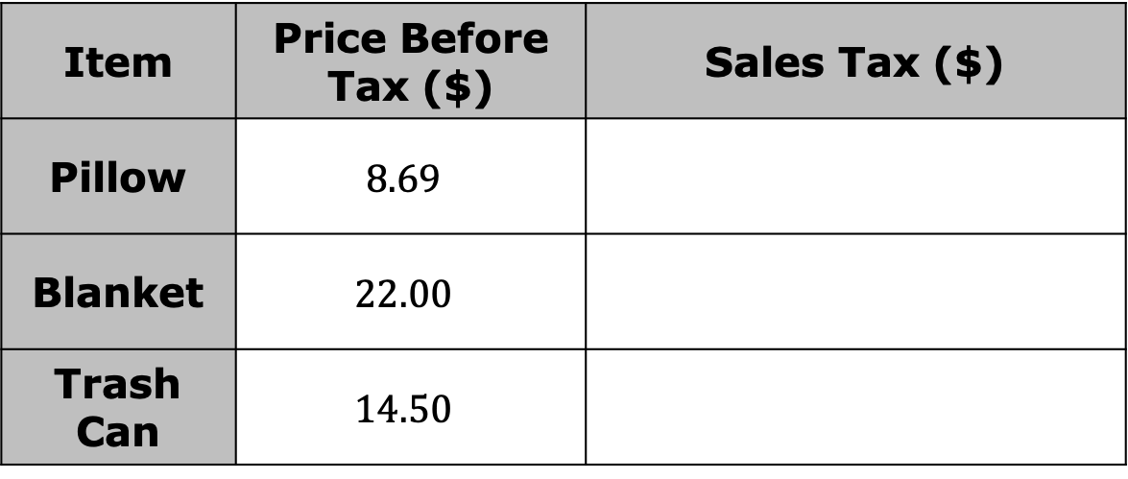
12.5.6 Your Turn!
A city in Ohio has a sales tax rate of $7.25\%$. Complete the table to determine how much sales tax is for each item.
Item | Price Before Tax ($) | Sales Tax ($)
Pillow | $$8.69$$
Blanket | $$22.00$$
Trash Can | $$14.50$$
volume 2, pg. 240

Slide 27
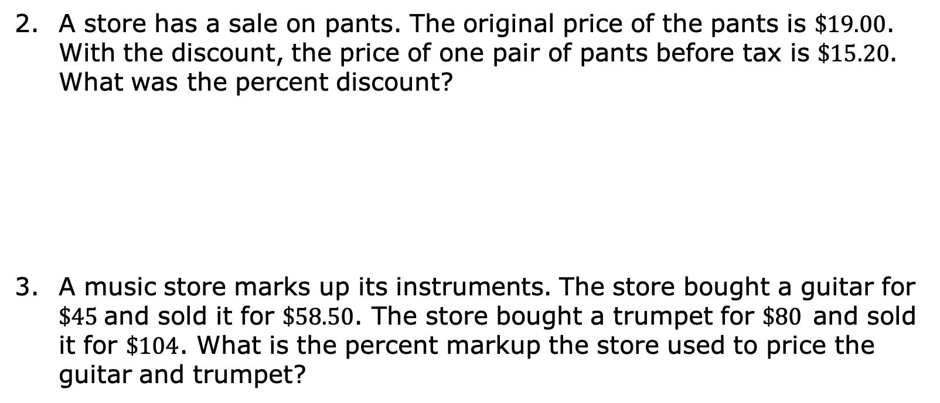
A store has a sale on pants. The original price of the pants is $\$19.00$. With the discount, the price of one pair of pants before tax is $\$15.20$. What was the percent discount?
A music store marks up its instruments. The store bought a guitar for $\$45$and sold it for $\$58.50$. The store bought a trumpet for $\$80$and sold it for $\$104$. What is the percent markup the store used to price the guitar and trumpet?
volume 2, pg. 240

Slide 28

Wrap-Up
volume 2, pg. 240

Slide 29
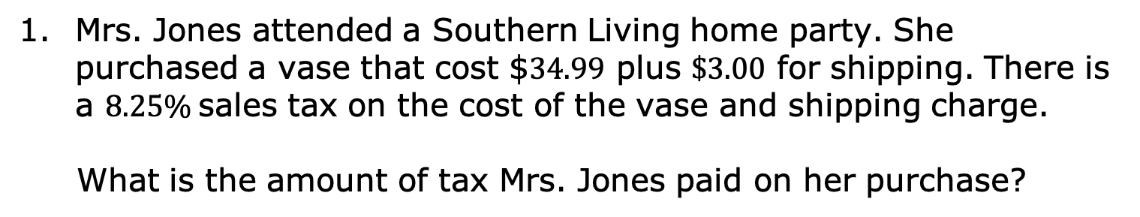
12.5.7 Wrap-Up: Ticket Out the Door
Mrs. Jones attended a Southern Living home party. She purchased a vase that cost $$34.99$ plus $\$3.00$ for shipping. There is a $8.25\%$sales tax on the cost of the vase and shipping charge.
What is the amount of tax Mrs. Jones paid on her purchase?
volume 2, pg. 240

